Slide 1
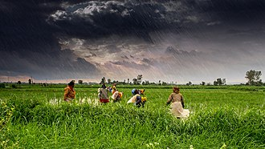
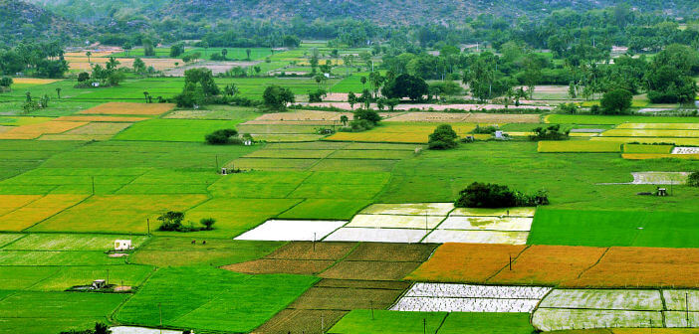
Integrated Farming: Success Stories and Insights from Indian Farms
Data-Driven Lessons for Sustainable Agriculture
Today, we explore how integrating multiple farming practices leads to successful, resilient, and sustainable farms.

Slide 2

Why Do Farms Struggle Today?
Many farms today face productivity and sustainability challenges due to monocropping and chemical dependency
Solid degradation
Loss of soil health and fertility from intensive farming practices
High input costs
Rising expenses for fertilizers, pesticides, and other chemical inputs
Climate Unpredictability
Erratic weather patterns threatening crop yields and farm stability

Slide 3
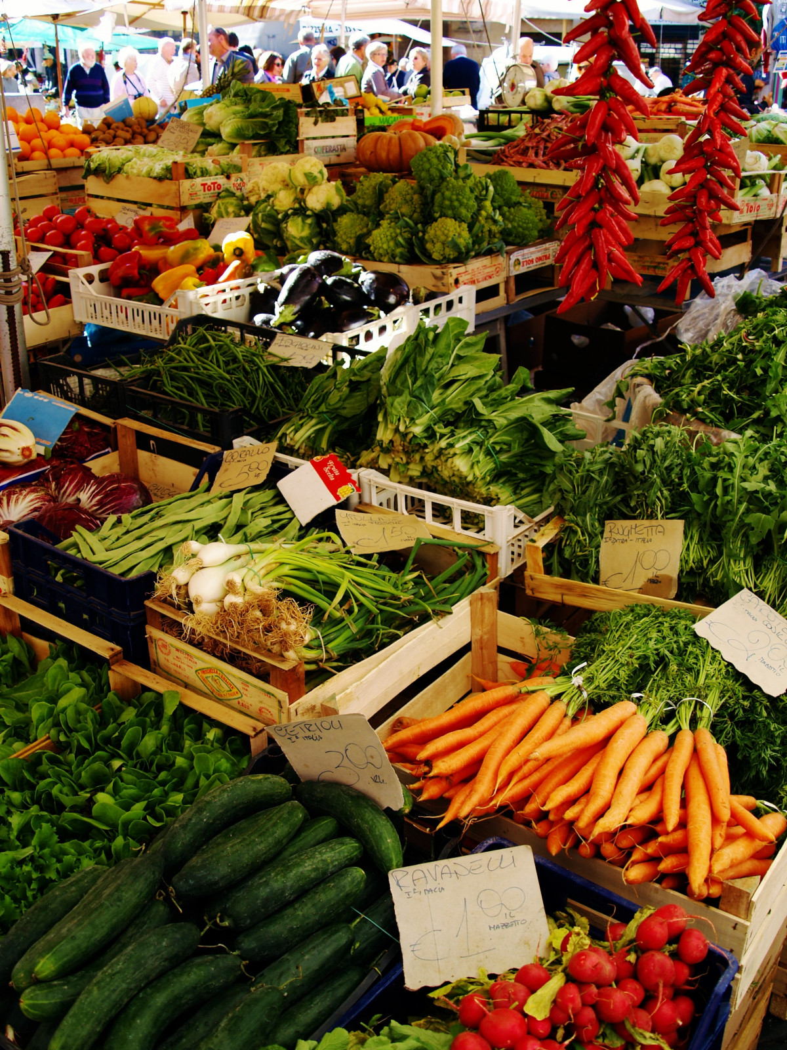
Data: Real Farmers, Real Success Stories
Our dataset provides a unique look into integrated farming across India, focusing on models that have demonstrated significant success.
250+ Farms Studied
Insights gathered from a robust sample of successful integrated farming models.
Key Practices Tracked
Detailed analysis of organic inputs, crop rotation, and livestock integration strategies.
Crop Diversity Examined
Investigating the role of multi-crop systems in enhancing farm resilience and productivity.
Pan-Indian Locations
Data encompasses farms operating in varied climates and geographical regions across India.
Tangible Outcomes Measured
Quantifying improvements in yield, farmer income, soil health, and water efficiency.

Slide 4
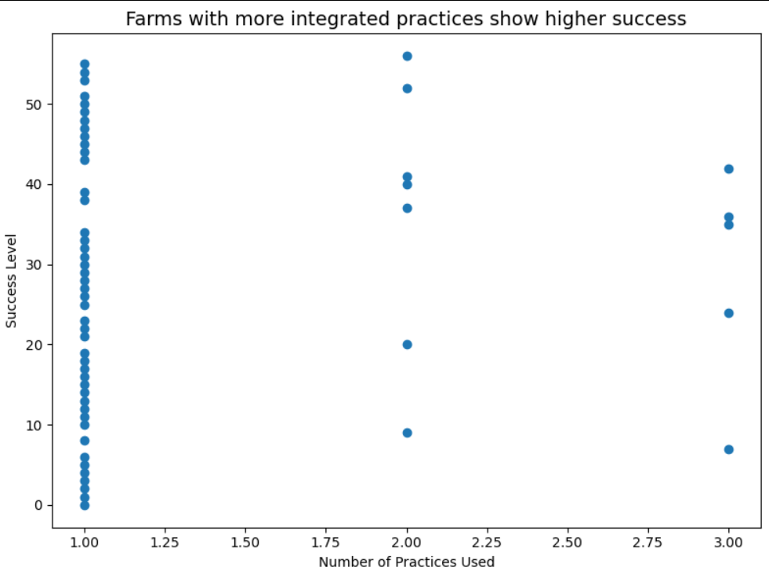
Farms that combine multiple practices achieve higher success
Farmers who integrate crops, livestock, organic inputs, and recycling see better outcomes than those using single practices
Highlight: Farms with the highest integration (all 4 practices) consistently achieve the best outcomes across all measured success indicators

Slide 5
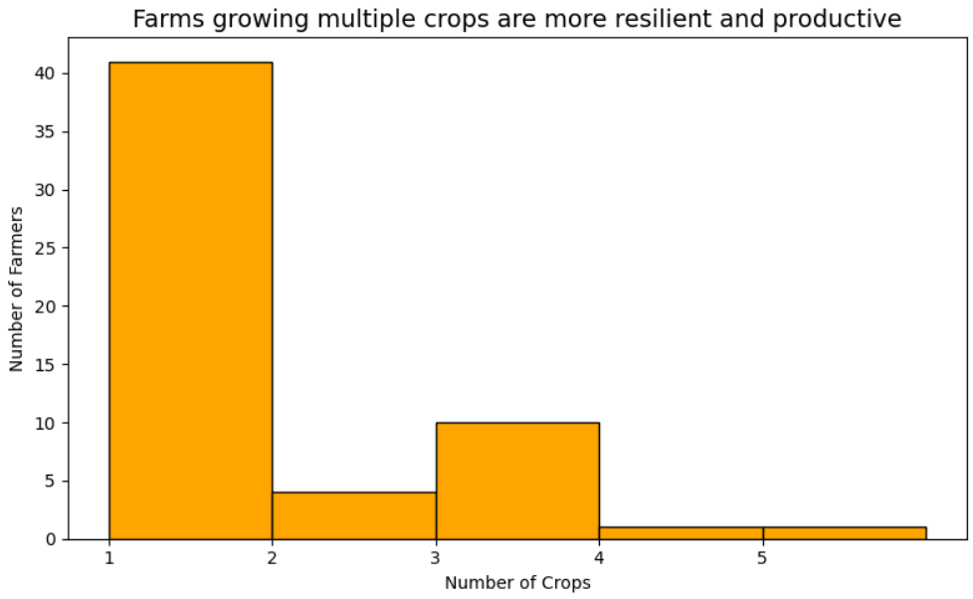
Crop diversity strengthens farm resilience
Growing multiple crops reduces risk from climate or pest problems and improves soil health
Highlight: Farms with 3+ crops represent the majority of successful integrated farms, demonstrating the resilience benefits of crop diversity

Slide 6
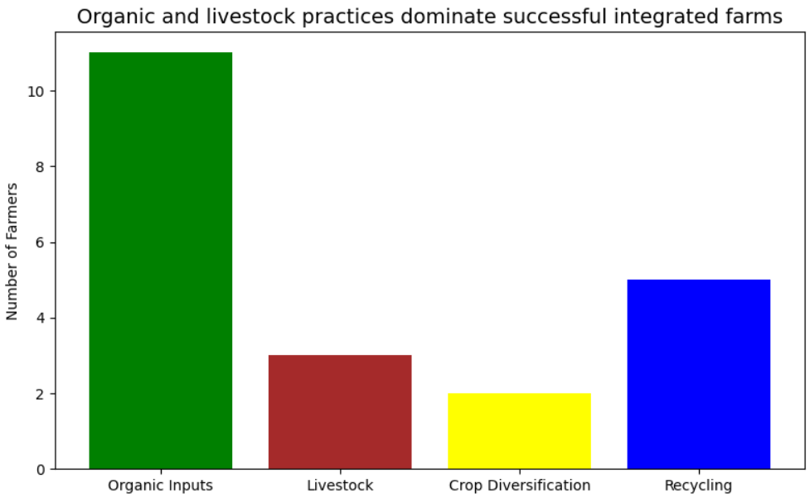
Organic and livestock practices dominate successful farms

Slide 7
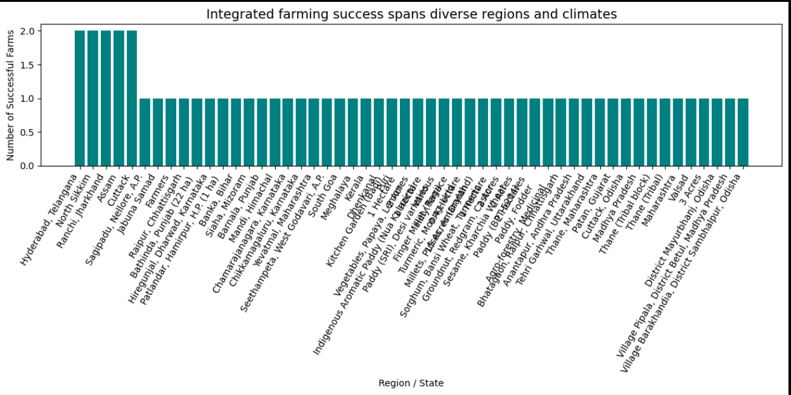
Integrated farming success spans diverse regions
This shows integrated farming works across different climates and soil conditions.
Highlight: Maharashtra, Punjab, and Karnataka show the highest counts of successful integrated farms, yet adoption spans arid, tropical, and temperate zones alike.

Slide 8
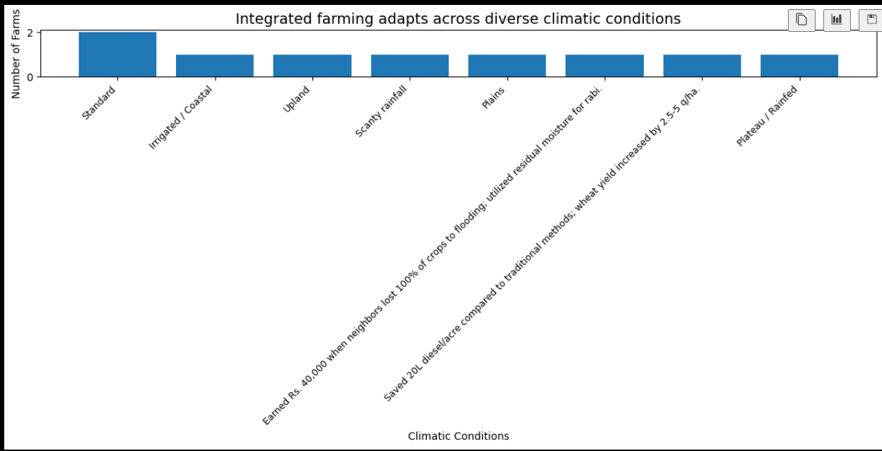
Climatic Distribution of Farms
To show that integrated farming practices are adaptable across different climatic conditions.

Slide 9
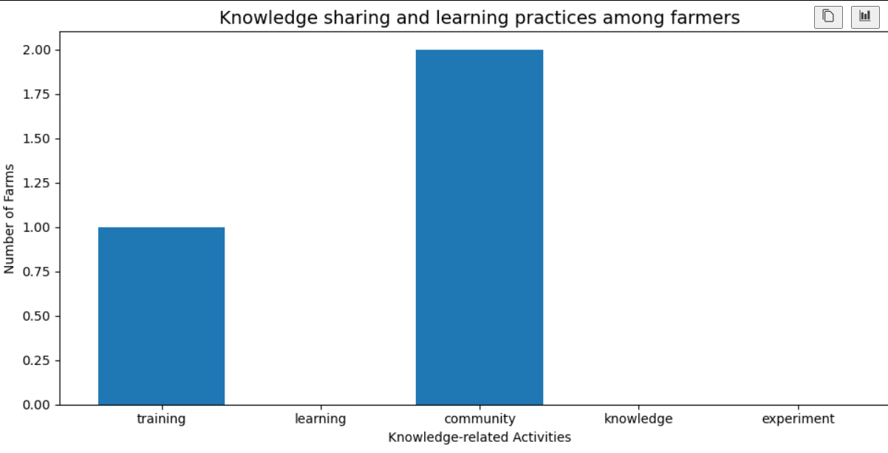
Knowledge Sharing Among Farmers
Purpose: Show the role of knowledge sharing, training, and learning in successful farming practices.

Slide 10
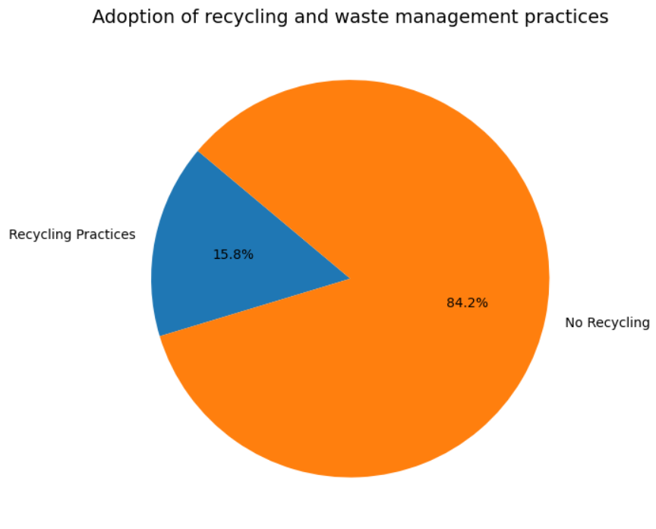
Recycling and Waste Management Practices
Purpose: Show the proportion of farms practicing recycling and waste management

Slide 11
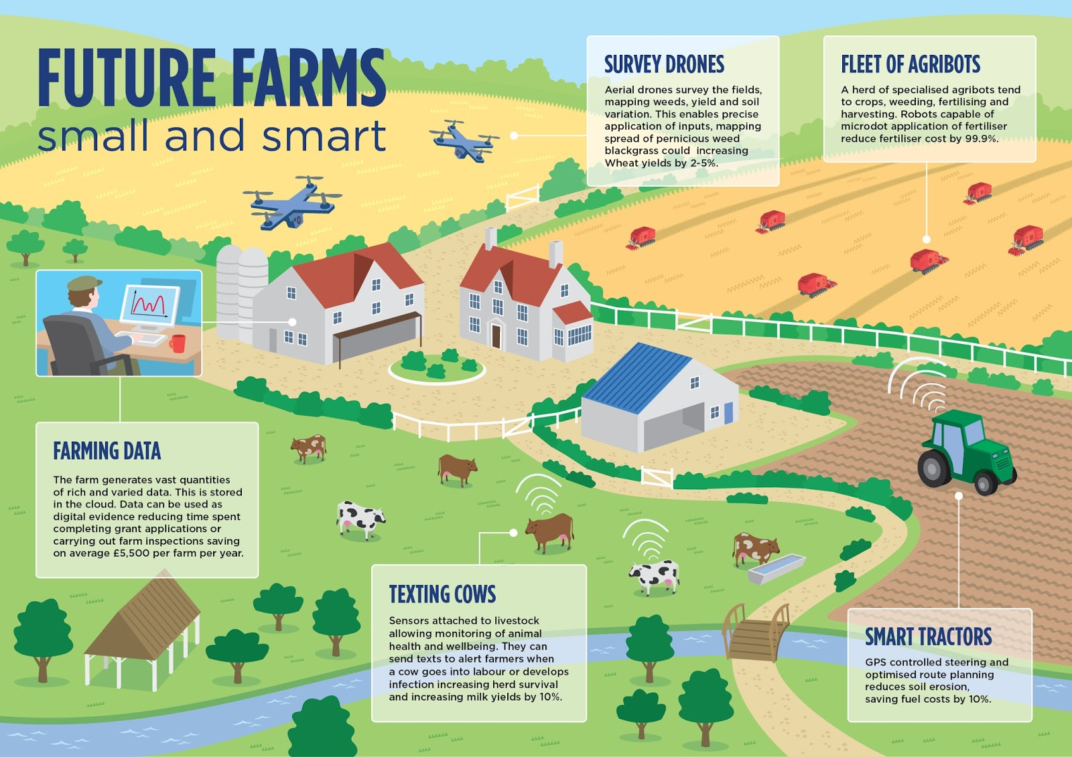

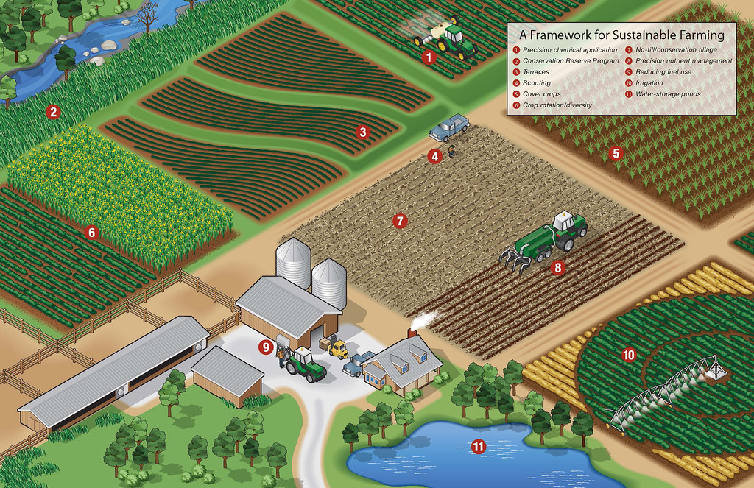
What Makes Integrated Farms Successful?
Analyzing data from successful farms reveals key drivers for resilience and productivity:
Diverse Practices: Integration of various farming methods across the ecosystem.
Crop Diversity: Cultivating multiple crops enhances resilience and soil health.
Organic Inputs: Utilizing low-cost, natural resources reduces expenses and enriches soil.
Live Stock Integration: Corporating animals adds value and facilitates nutrient cycling.
Knowledge Sharing: Community-driven learning and exchange of best practices.
Climatic Adaptability: Integrated farming practices adjust effectively to different climatic conditions, ensuring stable productivity across diverse environments.
Recycling Practices: Efficient waste management and recycling of farm by-products enhance sustainability and reduce dependency on external inputs.

Slide 12

Recommendations for Policymakers & NGOs
To foster widespread adoption and scale the success of integrated farming, strategic interventions are crucial
.
Support Training Programs
Equip farmers with integrated farming knowledge and skills through accessible, practical training initiatives.
Promote Organic Inputs
Reduce chemical dependency by subsidizing and facilitating access to affordable, quality organic alternatives.
Encourage Crop-Livestock Integration
Incentivize farms to adopt combined crop and livestock systems that build resilience and enhance productivity.
Facilitate Knowledge Sharing Networks
Build platforms and communities connecting successful integrated farmers with new adopters to share best practices.

